Slide 1

Time Series Analysis on Sunspots
Presented By,
Borui Lu
Sreelatha Yarragudi
Ravali Bogoni
Suneeth Ravilla

Slide 2
Contents
Data Description
Data Preparation
Analysis on monthly data
Analysis on Yearly data
Conclusion

Slide 3
What were the time-series data?
Sunspots are temporary phenomena on the Sun’s photosphere that appear as spots darker than the surrounding areas.
The amount of sunspots is related to temperature, sun’s activities, the effect of other planets, etc. However, it has a strong relationship with time.
According to history, their number varies approximately 11-year solar cycle.
Why were they selected?
The amount of sunspots is related to temperature, sun’s activities, the effect of other planets, etc. However, it has a strong relationship with time. In this way, the analysis for the number of sunspots and time is a good topic for time series analysis. Also, we can infer the activities of the sun, the temperature and a lot of solar system events from the analysis result.

Slide 4
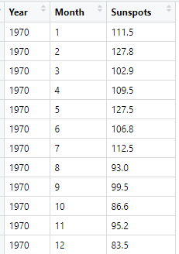
ABOUT DATASET
This dataset describes a monthly count of the number of observed sunspots
Data consists of 230 years (1749-1983).
The units are a count and there are 2,820 observations.
There is no missing value.
Divide the data, and keep the last 12 observations.
For Analysis, dropped last 12 observations for comparing prediction with actual values
> complete.cases(data)
> data1<-data[c(1:2808),]
> data2<-data[c(2809:2820),]

Slide 5
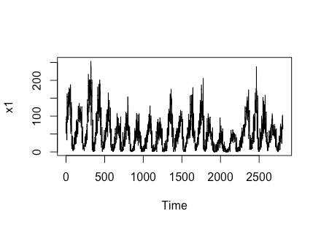
Plotting time series
From the time series plot, the number of sunspots for different months are fluctuating across the years.
The plot is changing over time, it is not having constant mean and variance. The data seems not to be stationary
> x<-subset(data1, select = Sunspots)
> x1<-ts(x)
> ts.plot(x1)

Slide 6
Stationary test
From Augmented Dickey fuller test, as all the p-values are less than 0.05 the data is stationary.
> adf.test(x1)
Augmented Dickey-Fuller Test
alternative: stationary
Type 1: no drift no trend
lag ADF p.value
[1,] 0 -8.55 0.01
[2,] 1 -6.67 0.01
[3,] 2 -5.88 0.01
[4,] 3 -5.19 0.01
[5,] 4 -4.69 0.01
[6,] 5 -4.27 0.01
[7,] 6 -3.98 0.01
[8,] 7 -3.63 0.01
[9,] 8 -3.18 0.01
Type 3: with drift and trend
lag ADF p.value
[1,] 0 -13.60 0.01
[2,] 1 -10.79 0.01
[3,] 2 -9.58 0.01
[4,] 3 -8.51 0.01
[5,] 4 -7.71 0.01
[6,] 5 -7.04 0.01
[7,] 6 -6.60 0.01
[8,] 7 -6.06 0.01
[9,] 8 -5.36 0.01
----
Note: in fact, p.value = 0.01 means p.value <= 0.01
Type 2: with drift no trend
lag ADF p.value
[1,] 0 -13.43 0.01
[2,] 1 -10.64 0.01
[3,] 2 -9.45 0.01
[4,] 3 -8.40 0.01
[5,] 4 -7.62 0.01
[6,] 5 -6.96 0.01
[7,] 6 -6.53 0.01
[8,] 7 -6.00 0.01
[9,] 8 -5.31 0.01

Slide 7
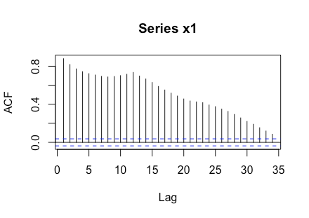
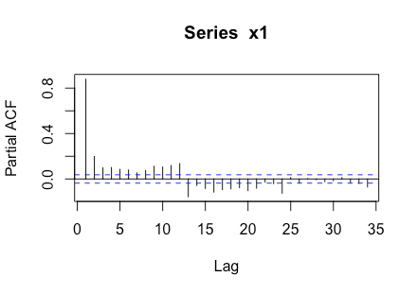
ACF & PACF
The ACF plot shows, the autocorrelation is gradually decreasing for the number of sunspots and decaying to zero
PACF plot shows 1 peak value, there is a significant correlation at lag 1 and followed by correlations that are not significant as there are almost zero.
These patterns represent an AR component
<-acf(x1,plot=T)
<-pacf(x1,plot=T)

Slide 8
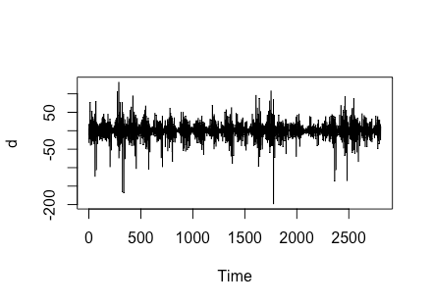
Lag-1 difference data
Taking Lag-1 difference data to identify the better model.
Mean is constant with little variation in data.
> x11=lag(x1,1)
> d=x11-x1
> ts.plot(d)

Slide 9
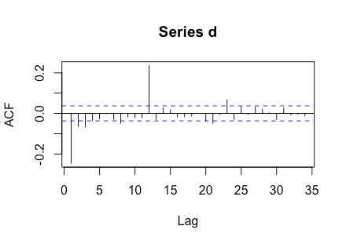
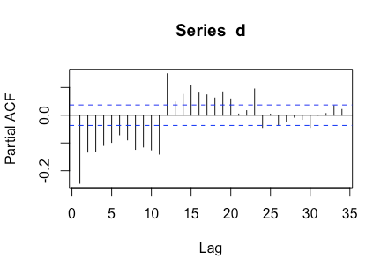
ACF & PACF
From ACF plot, we can see large spike in lag 1 followed by sine wave that alternates between positive and negative correlations that are not significant.
From PACF plot, the pattern shows large spike and decreases after few lags, this determines auto correlation function to determine the order of the moving average term.
From the plots, we can determine the data follows both AR and MA components.
> acf(d)
> pacf(d)

Slide 10
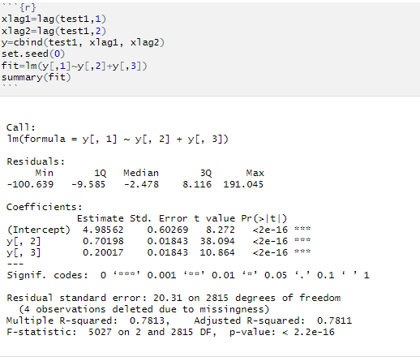
Linear Model
Linear model is performed on lag1 and lag2 with data being response variable.
p value of both are variables are less than 0.05, therefore the lag1 and lag2 variables are significant.
Linear model is significant with residual standard error 20.31
fit = 4.985 - 0.7019 (Lag1) + 0.2002(Lag2)

Slide 11
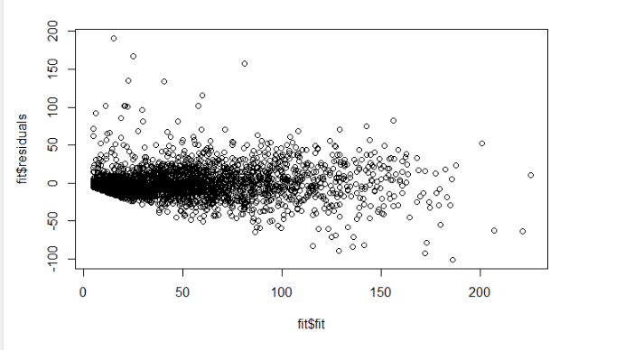
Residual plot of Linear Model
There is no trend or pattern is followed by the residual plot of model, this shows that the model sufficiently catches the data patterns.
> plot(fit$fit, fit$residuals

Slide 12
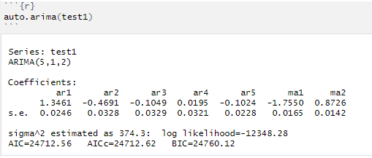
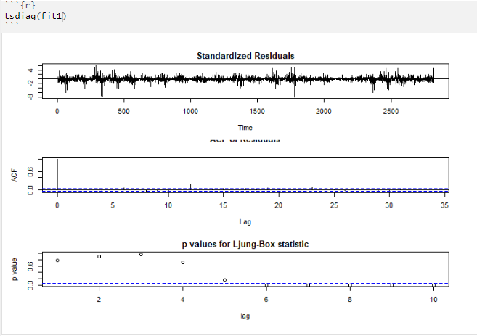
ARIMA Model
From the arima output, the data follow ARIMA(5,1,2)
On observing the coefficients AR(4) coefficient is not significant as the fluctuation error is higher than the value and AR(5) is almost closer to error value.
From the diagnosis test, the p-values are less than 0.05, therefore the model is not significant.
We will verify taking ARIMA(3,1,2) model.
> fitts = arima(test1, order=c(5, 1, 2))
> fitts

Slide 13
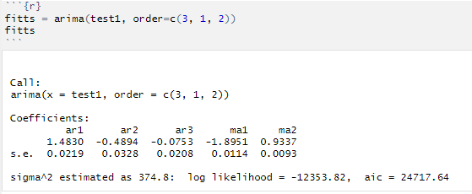
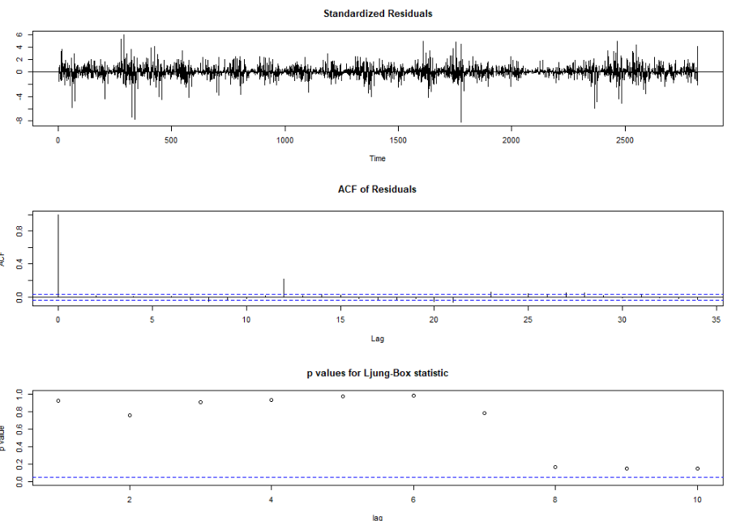
ARIMA Model
By diagnosis test, the ARIMA(3,1,2) is significant as all p-values is greater than 0.05.
Therefore ARIMA(3,1,2) model captures all the data.
The fitted model,
d_{t} = 1.4830d_{t-1}- 0.4894d_{t-2}-0.0753d_{t-3} + Z_{t} + 1.8951Z_{t-1} - 0.9337 Z_{t-2}

Slide 14
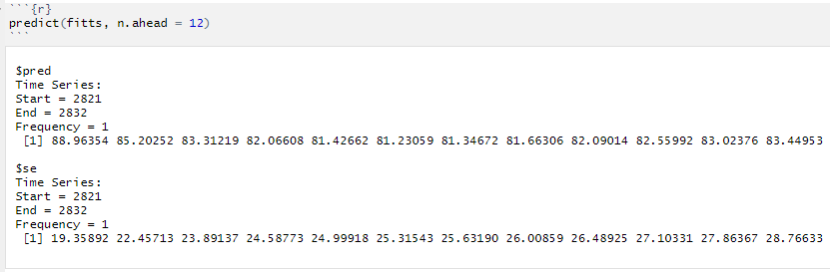
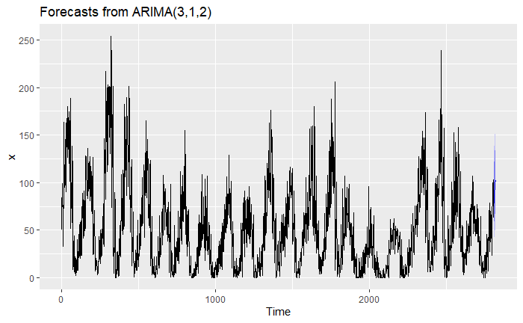
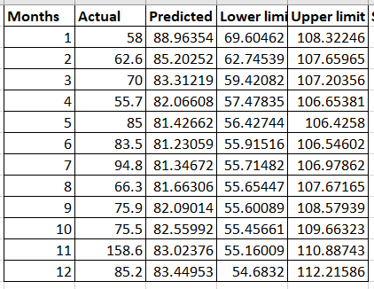
Forecasting
On comparing predicted and actual values, some predicted values are closer to actual and some values are deviated from actual values.

Slide 15
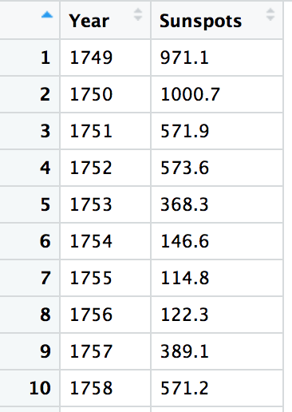
Aggregating SunSpots by Year
As the residual plot, null hypothesis is rejected for higher lags.
Performed analysis by aggregating the sum of the SunSpots each year
Now data consists of 235 records from year 1749 - 1983
Last 10 years records are moved into dat2 for forecast comparison
First 225 years are considered for the analysis
> yeardat = aggregate(Sunspots~Year,data = data,FUN = "sum")
>dat1 <- yeardat[c(1:225),]
>dat2 <-yeardat[c(226:235),]

Slide 16
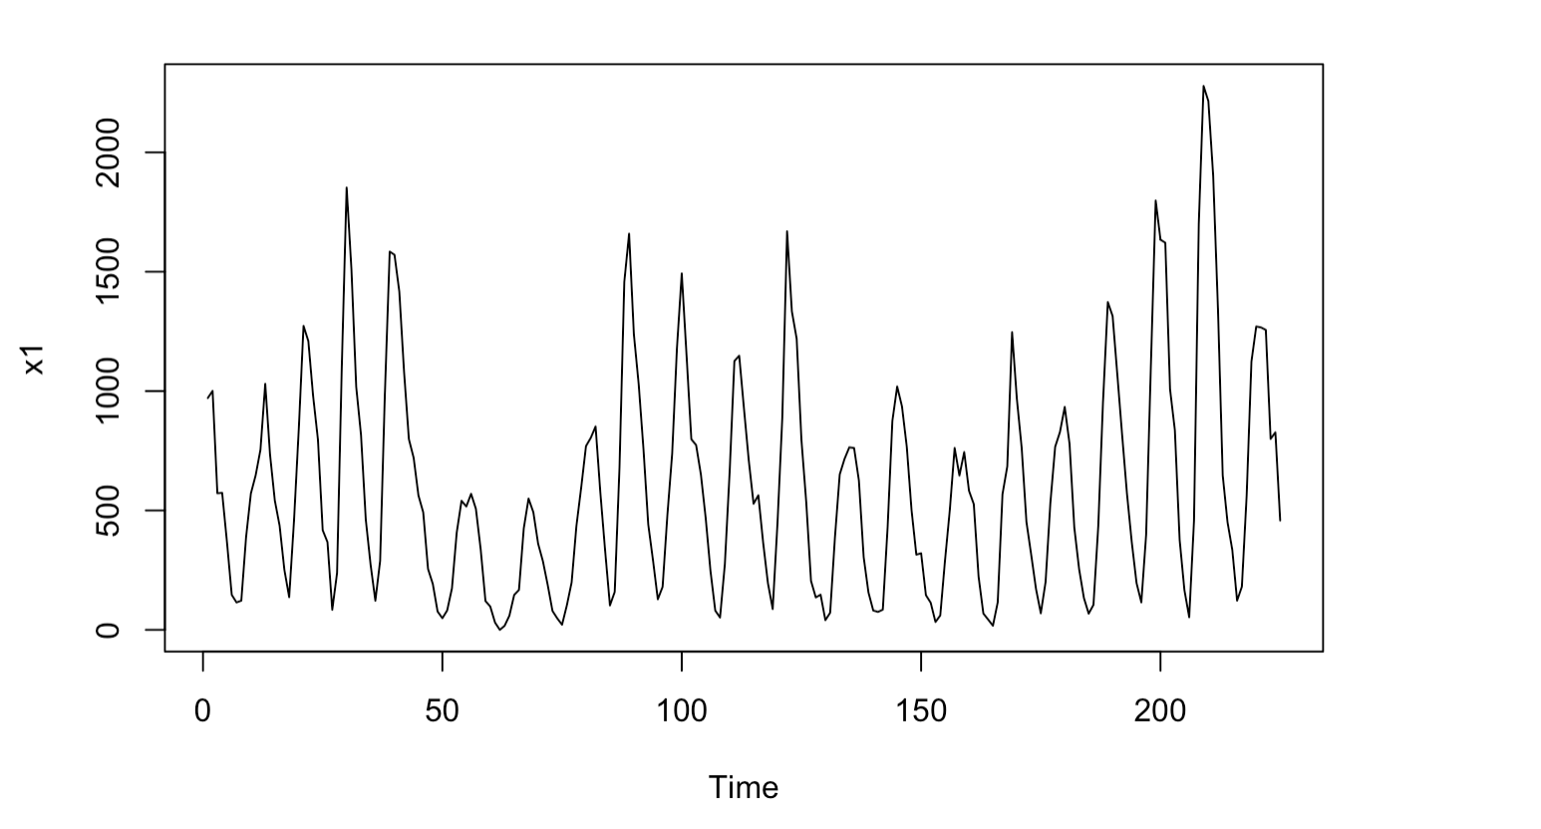
Plotting Time Series
From time series plot, the data points are fluctuating - no periodic effect
The plot is changing over the time, it is not having constant mean and variance. We will check stationary of data by performing Dickey-fuller test.
x<-subset(dat1, select = Sunspots)
x1<-ts(x)
ts.plot(x1)

Slide 17
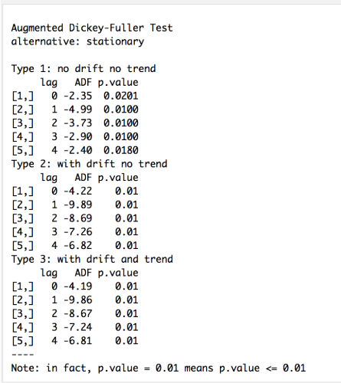
Stationary test
For all the type 1,2 and 3 we see that p value is less than 0.05. We reject null hypothesis saying the data is stationary at 5% level of significance.
> t <- data.matrix(x[1:225,])
> stationary.test(t)

Slide 18
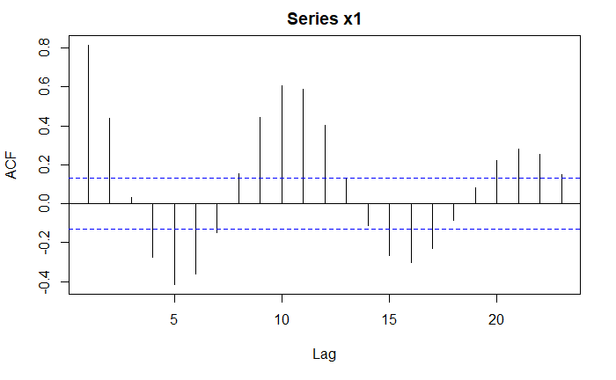
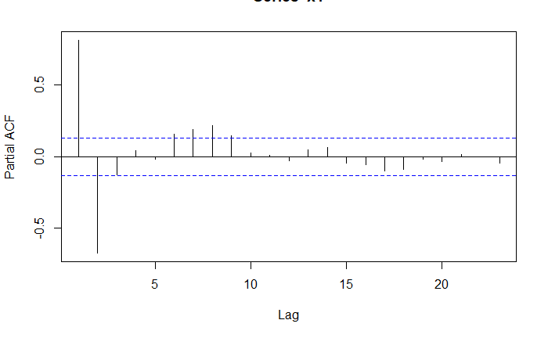
ACF & PACF
The ACF plot shows, lag 1 has highest correlation around 1 and remaining lags decaying to zero. Hence MA(1) component is expected.
From PACF plot, 2 peaks of lags indicate AR(2) component is expected.
These patterns represent the data follows AR and MA components.
<-acf(x1,plot=T)
<-pacf(x1,plot=T)

Slide 19
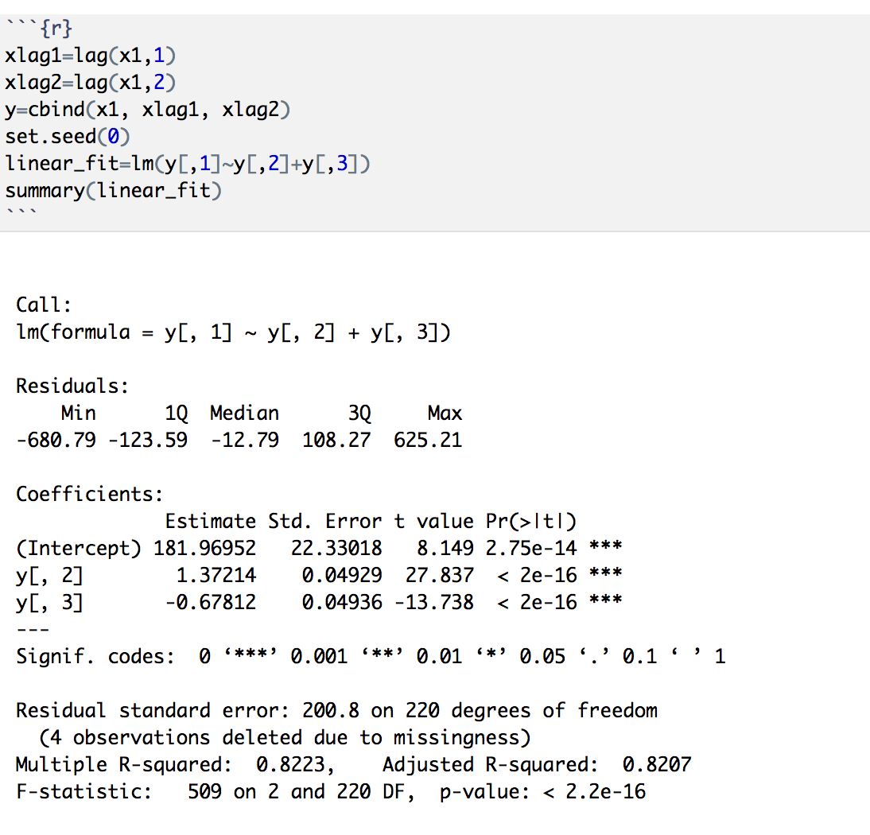
Linear Model
Linear model is performed on lag1 and lag2 with data being response variable.
p value of both are variables are lesser than 0.05
Linear model is significant.
data = 181.969 + 1.372 (Lag1) - 0.678 (Lag2)

Slide 20
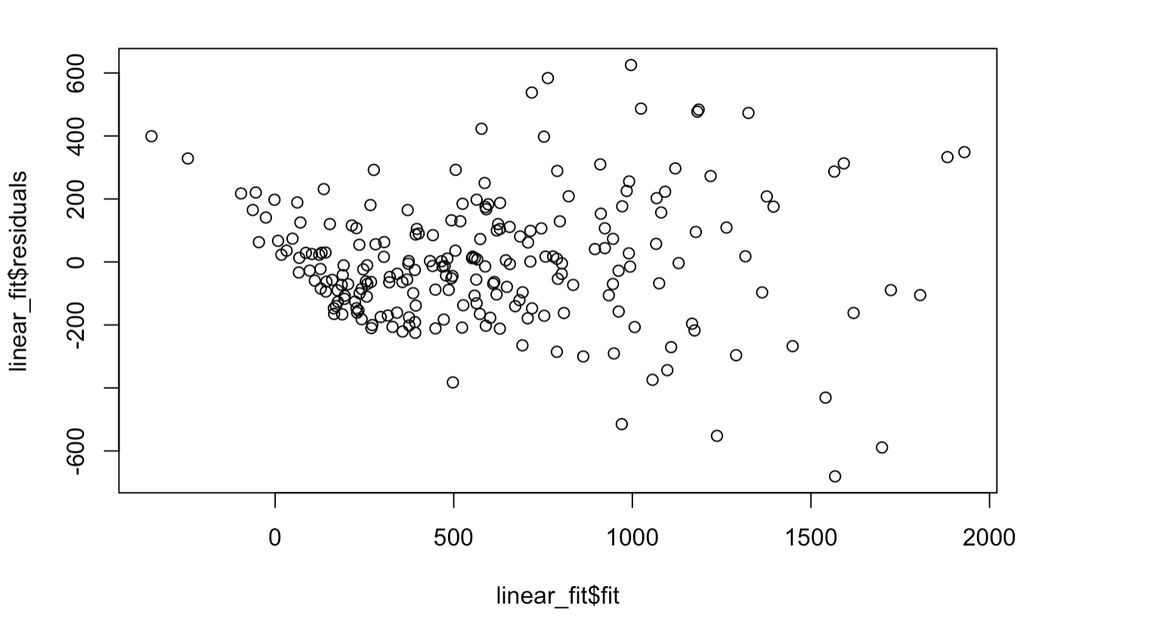
Residual Plot of linear model
There is no trend or pattern is followed by the residual plot of model, this shows that the model sufficiently catches the data patterns.
> plot(linear_fit$fit, linear_fit$residuals

Slide 21
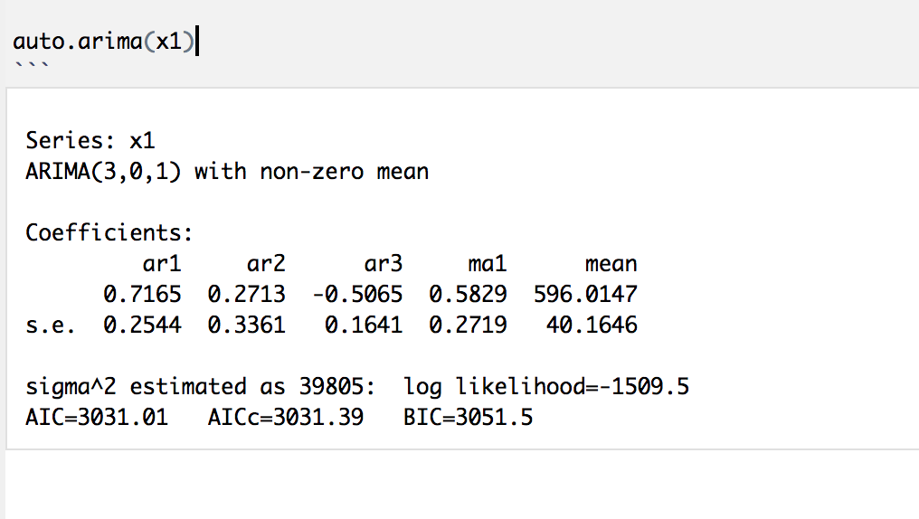
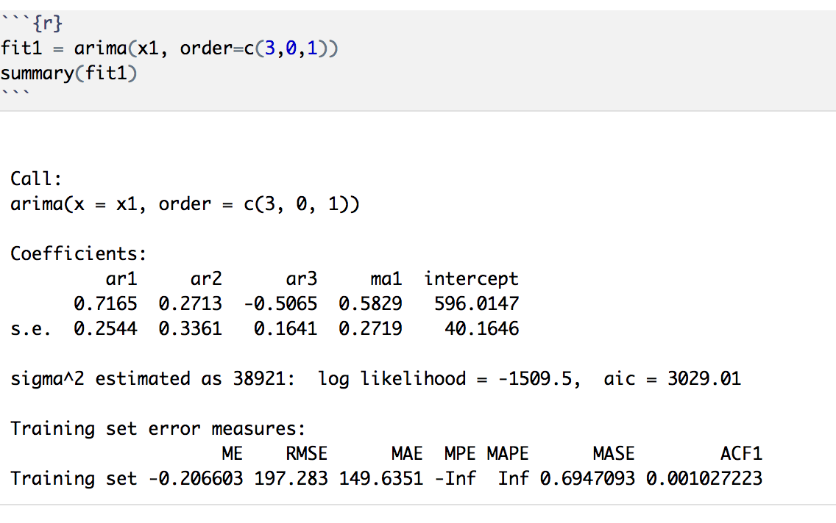
ARIMA Model
From the arima model output we can observe that data follows ARIMA(3,0,1) i.e., ARMA(3,1)
On observing coefficients, AR(2) coefficient is not significant as the fluctuation error is higher than the value.
Therefore fit the model with AR(2) component as ‘0’

Slide 22
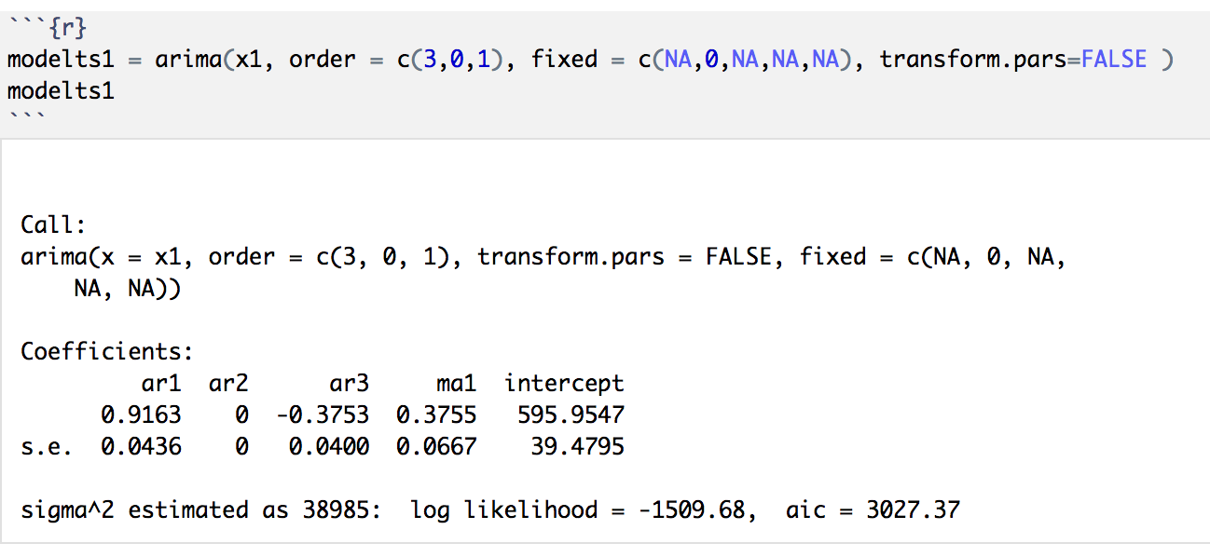
ARIMA Model
On observing AIC values of fit1 and modelts1, the AIC value for modelts1 is lower than fit1 model.
The fitted model for the data would be,
Y_{t} = 595.9547 + 0.9163(Y_{t-1}-595.9547) - 0.3753 (Y_{t-3}- 595.9547) + Z_{t} – 0.3755Z_{t-1}

Slide 23
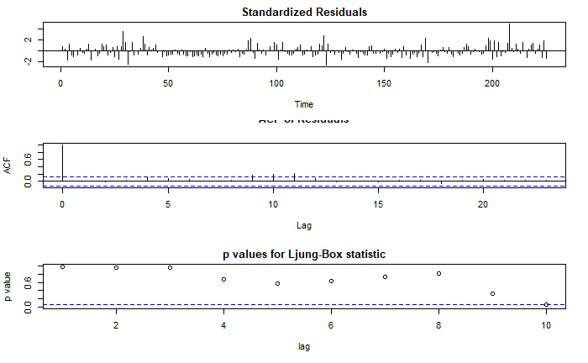
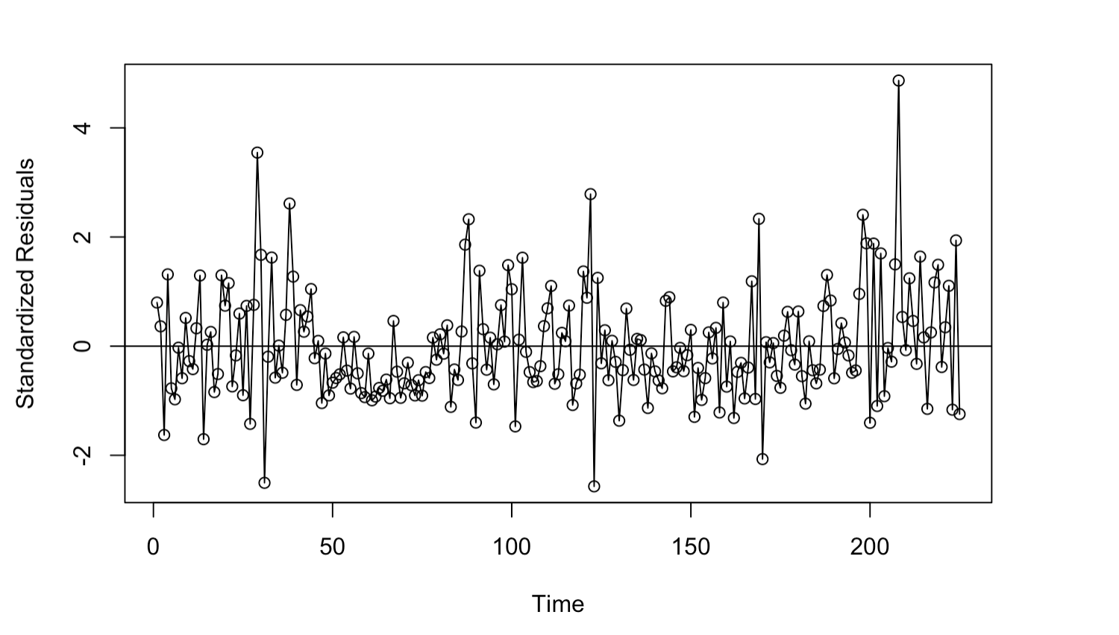
TS Diagnosis
From Ljung-Box statistic we can see almost all the p values are significant but with a slight white noise.
From Standardized residuals we can see the white noise resulting the graph with extra peeks.
> tsdiag(fit1)

Slide 24
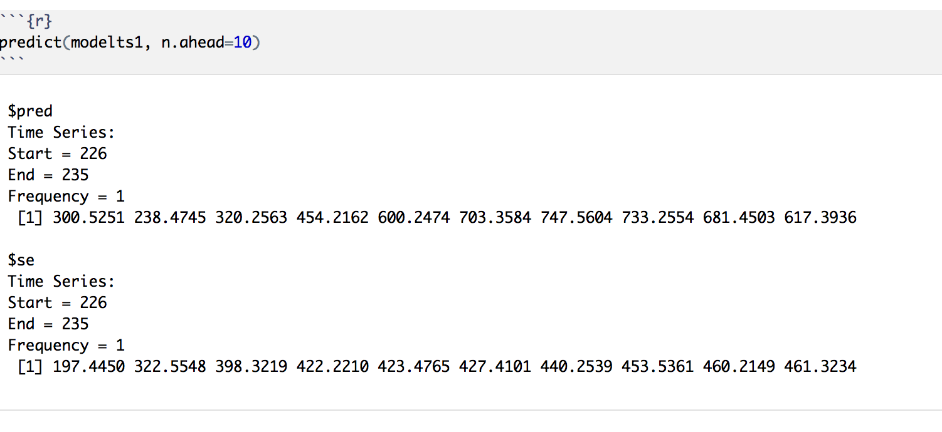
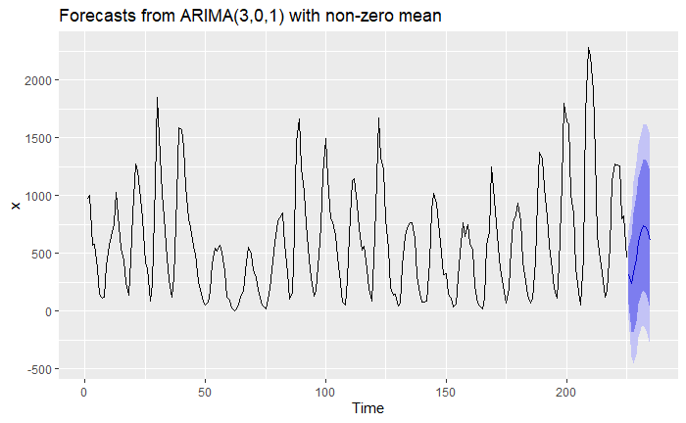
Forecasting
Using fitted model “modelts1”, Predicted 10 ahead values for 10 years.
Forecast has followed the trend along with the data
> predict(modelts1, n.ahead=10)
> autoplot(forecast(fit1))

Slide 25
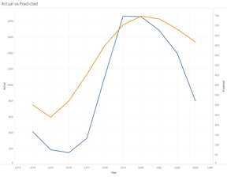
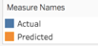
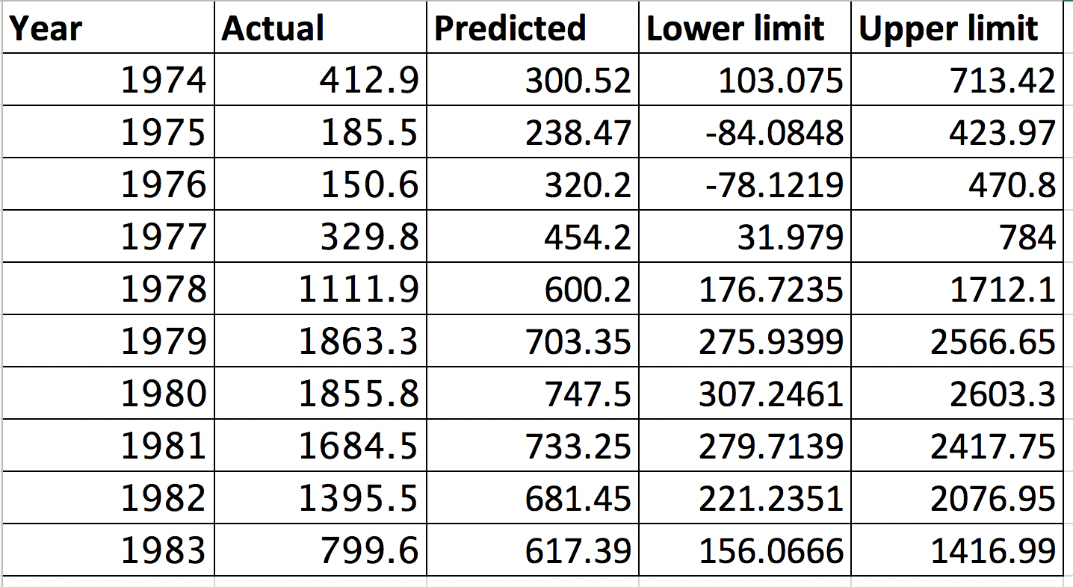
Forecasting Plot
From the Actual vs Predicted plot, Predicted values are not much deviated from the actual trend.
The predicted values are within the range of lower and upper limits.
Hence the fitted model is forecasting significantly.

Slide 26
Conclusion
For the Monthly data of sunspots,
Original data is stationary and fitted a linear model with lag 1 and lag 2
The residuals of the fitted model are not following any patterns which state the linear model captures all the data
ACF and PACF plots of original data and Lag-1 difference didn’t help in identifying the candidate model.
From ARIMA, the data follows AR(3) effect on lag-1 difference data with MA(2) effect.
The data is forecasted for the next twelves month. On comparing predicted values with actual values the point estimates are not exactly the same with respect to actuals however the predicted values are within the prediction interval.

Slide 27
Conclusion
For the Yearly data of sunspots,
Original data is stationary and fitted a linear model with lag 1 and lag 2
The residuals of the fitted model are not following any patterns which state the linear model captures all the data
From ACF and PACFplots, we identified the data follows AR and MA components
For the yearly data of sunspots, the data follows AR(3) effect and MA(1) effect i.e., model is ARMA(3,1).
The data is forecasted for the next years. On comparing predicted values with actual values the point estimates are closer to actuals however the actual values are within the prediction interval.

Slide 28
Difficulties
While identifying the candidate model for monthly data, we were confused about whether to take ARIMA(3,1,2) model or we should consider the model the which we got from arima output i.e., ARIMA(5,1,2)
Real life prediction
The data final models would help is predicting in the number of sunspots in each month which in turn helps to forecast the variation in the temperature. This means that more sunspots deliver more energy to the atmosphere, so that global temperatures would rise.

Slide 29
THANK YOU
ANY QUESTIONS?

